Slide 1

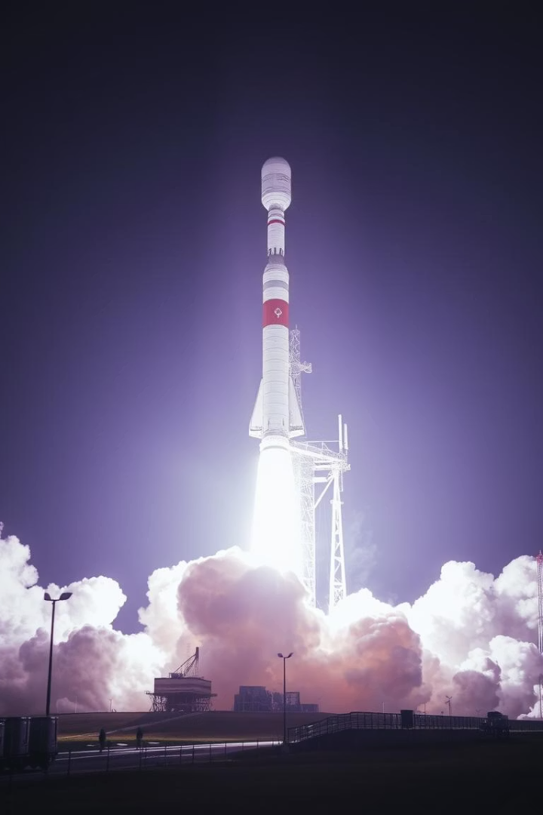
🚀 SpaceX Falcon 9 Launch Analysis: From Exploration to Prediction
Capstone Project – Data Science Professional Certificate By Avipsha Swain | June 2025
By Arpita Mishra
AS
Notes:
1

Slide 2

Executive Summary
This project analyzes SpaceX Falcon 9 launch data, exploring trends and building predictive models.
Data Wrangling
SQL-based analysis
Visual Analytics
Matplotlib, Seaborn, Plotly
Interactive Tools
Folium, Plotly Dash
Predictive Modeling
Classify mission outcomes
Notes:
2

Slide 3
Introduction & Data Collection
Understand SpaceX launch patterns and predict landing outcomes from historical Falcon 9 mission data.
Key Features
Methodology
Flight Number
Data cleaning (nulls, types)
Payload Mass
One-hot encoding (Orbit, LaunchSite, Serial, etc.)
Orbit
Launch Site
Mission Outcome
Landing Pad
Booster Version
Notes:
3

Slide 4
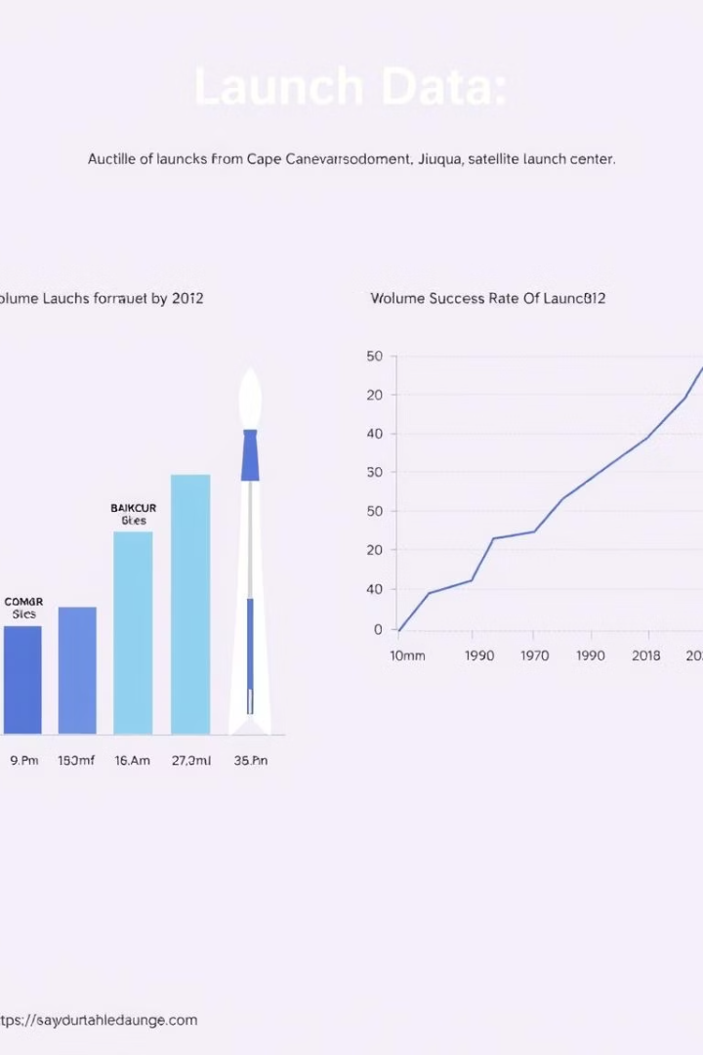
Exploratory Data Analysis (EDA)
EDA provides insights into launch locations, success rates, and payload impacts.
Launch Sites
Success Rate
Most launches from CCAFS LC-40 and KSC LC-39A
Generally increased with Flight Number (experience)
Payload Impact
Heavier payloads didn’t guarantee failure; other factors matter
Notes:
4

Slide 5




SQL-Based Analysis
Used SQL queries in Jupyter with %sql magic to extract key insights.
Launch Counts
By site
Payloads
Minimum/maximum
Mission Outcomes
Most common per site
Key Query Example:
SELECT Launch_Site, COUNT(*) AS Launch_Count FROM SPACEXTBL GROUP BY Launch_Site;
Notes:
5

Slide 6






Interactive Map (Folium)
A Folium map visually presents global launch distribution and site statistics.
Popups
Site name & mission stats
Custom Markers
For each launch site
MarkerCluster
Handles overlapping points
Notes:
6

Slide 7
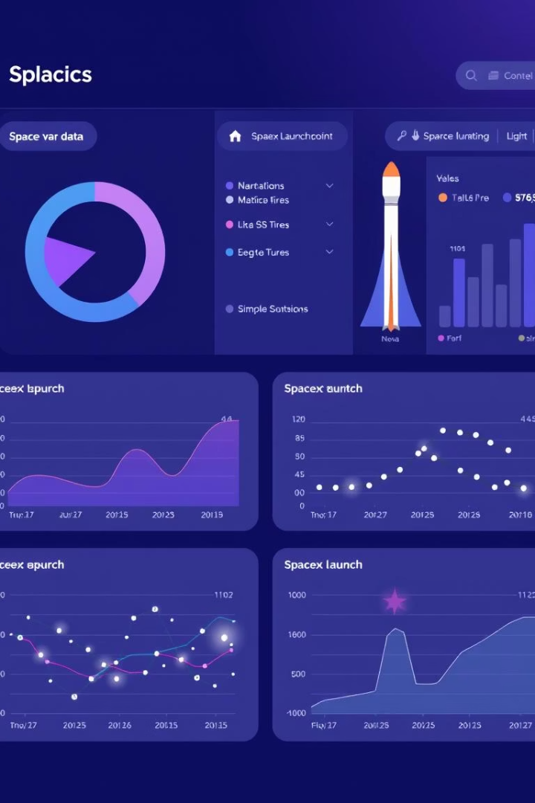



Interactive Dashboard (Plotly Dash)
A dashboard built with Dash + Plotly offers real-time exploration of launch outcomes.
Dropdown Filters
By launch site
Pie Charts
Success vs. failure
Scatter Plots
Payload vs. Success, colored by Orbit
Notes:
7

Slide 8





Predictive Analysis (Classification)
The goal is to predict successful landings using various models.
Decision Tree
Best Accuracy: 83.33%
Support Vector Machine
Best Kernel: Linear
Logistic Regression
KNN
Features: Payload, Orbit, Landing Pad, Booster Version, Serial
Notes:
8

Slide 9






Conclusion & Insights
Key factors and effective tools for analyzing SpaceX launches.
Success Drivers
Launch site & orbit type
Model Effectiveness
Decision Trees are interpretable and effective
Communication
Visual dashboards allow easy trend communication
Bonus: Applied custom styling, Folium clusters, and additional Orbit analysis for enhanced insight.
Notes:
9

Slide 10

Submission & Links
All project requirements have been completed.
Requirements Completed
PDF Presentation
Executive Summary ✅
GitHub Repo
Uploaded
EDA, SQL, Folium, Dash, ML Slides ✅
[Insert your URL]
Innovation & Creativity ✅
📧 Thank you!
Notes:
10

